Slide 1
ANALYSIS OF RLC CIRCUIT
BY
AMAN CHHAJED
2014B4A7608G

Slide 2
Basic RLC Circuit
L= Inductance
R=Resistance
C=Capacitance
V = Voltage
q=Charge
dq/qt=I

Slide 3
FARADAY’S LAW

Slide 4
OHM’S LAW

Slide 5
COULOMB’S LAW
The Voltage drop across
the Capacitor=

Slide 6
KIRCHHOFF’S VOLTAGE LAW

Slide 7
2nd order differential equation:
For the case where the source is an unchanging voltage, differentiating with respect to t and dividing by L leads to the second order differential equation:

Slide 8
The differential equation
Substituting V = IR in the previous equation we get

Slide 9
The characteristic equation

Slide 10
Eigenvalues of the characteristic equation:

Slide 11
Three Cases
Overdamped
Critically damped
Underdamped

Slide 12
Three Cases
Over damped
Critically damped
Under damped

Slide 13
Illustration
V(0) = 3
V’(0) = 0
L = 0.003 C = 1e-10
For critically damped case,

Slide 14
Overdamped Case
R = 11000 (>10954.45)
2 real roots of the characteristic equation.
S₁ = -1.6667e+6
S₂ = -2e+6
The voltage is not oscillatory and decays to equilibrium.
Energy loss in resistor is faster than energy transferred.

Slide 15
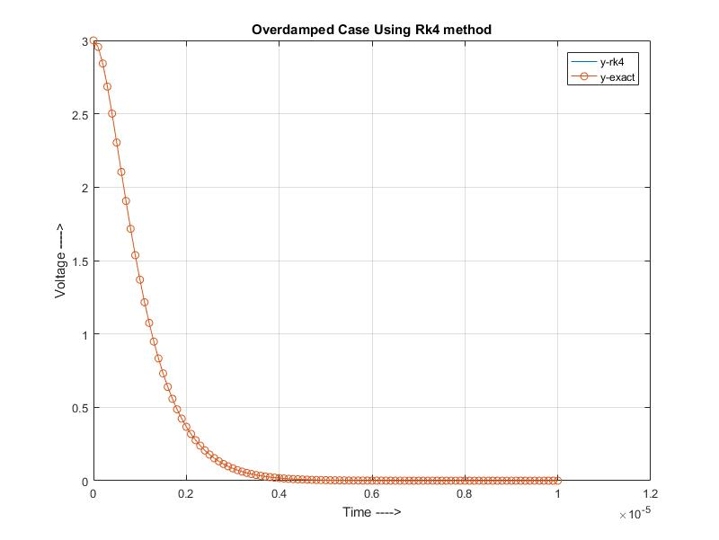

Slide 16
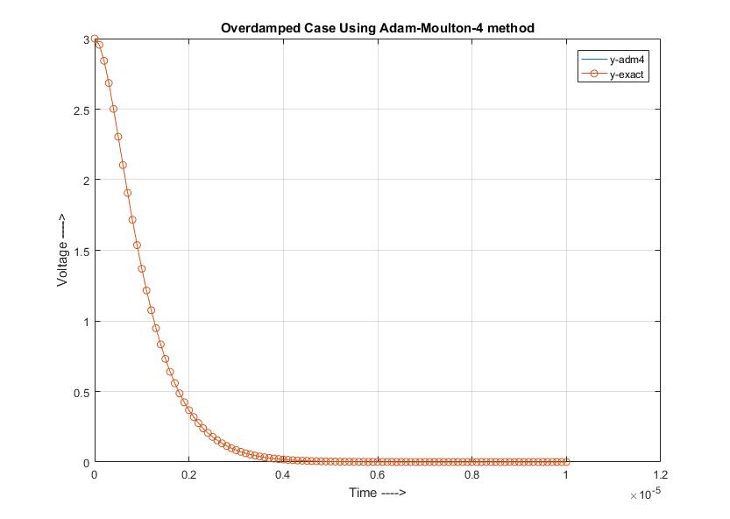

Slide 17
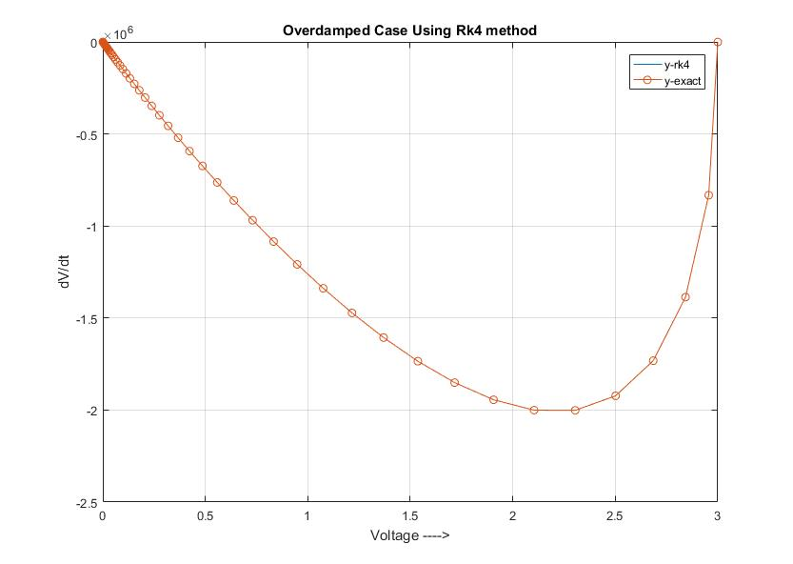

Slide 18
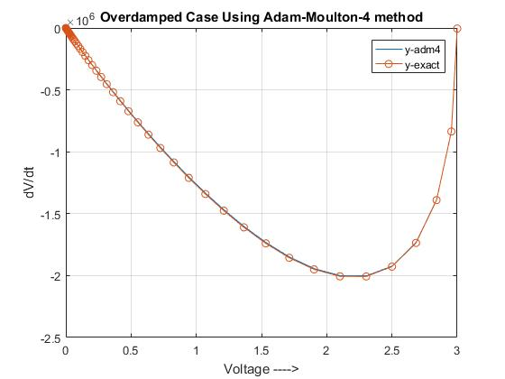

Slide 19
Critically damped Case
R = 10954.45
2 equal real roots of the characteristic equation.
S = -1.8257e+6
The voltage returns to equilibrium in the minimum time and there is just enough damping to prevent oscillation.

Slide 20
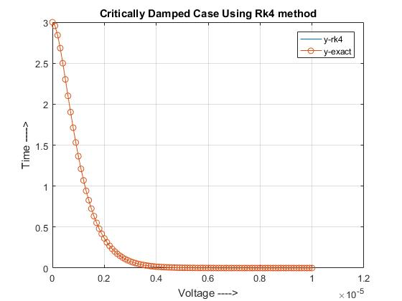

Slide 21
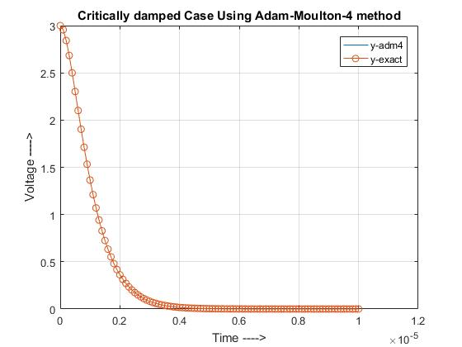

Slide 22
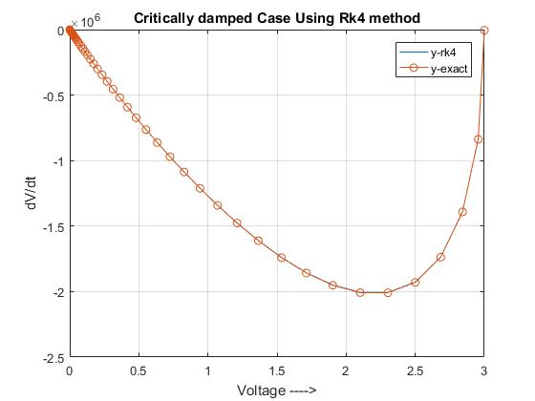

Slide 23
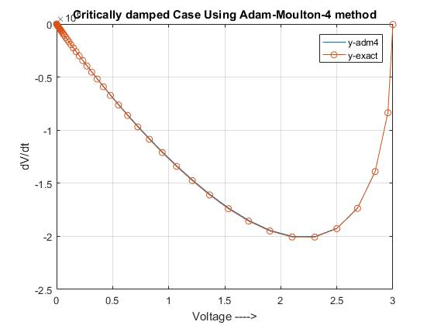

Slide 24
Under damped Case
R = 300 (<10954.45)
2 imaginary roots of the characteristic equation.
S₁ = -5e+4 + i1.825e+6
S₂ = -5e+4 – i1.825e+6
The voltage is oscillatory, amplitude decreases exponentially and finally it decays to equilibrium.

Slide 25
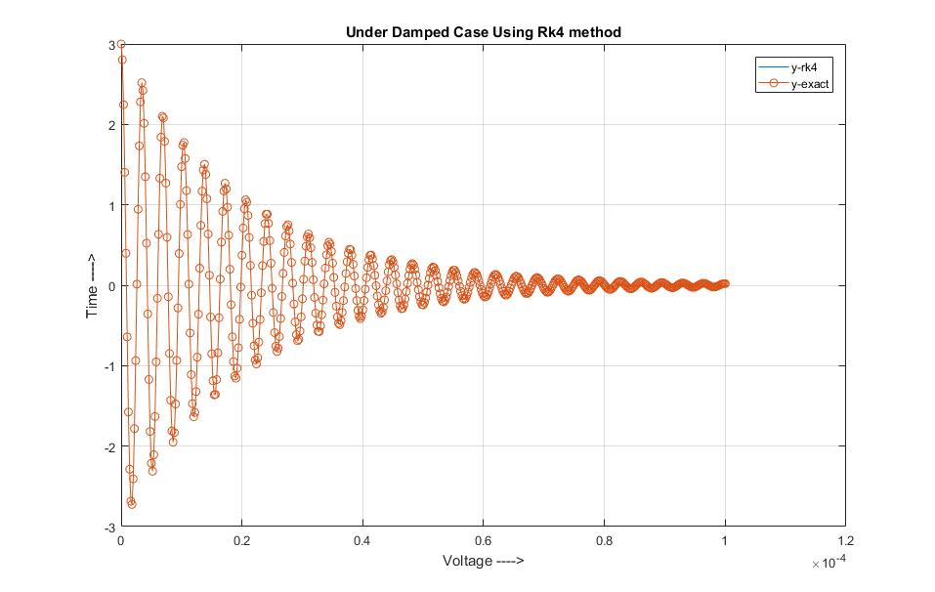

Slide 26
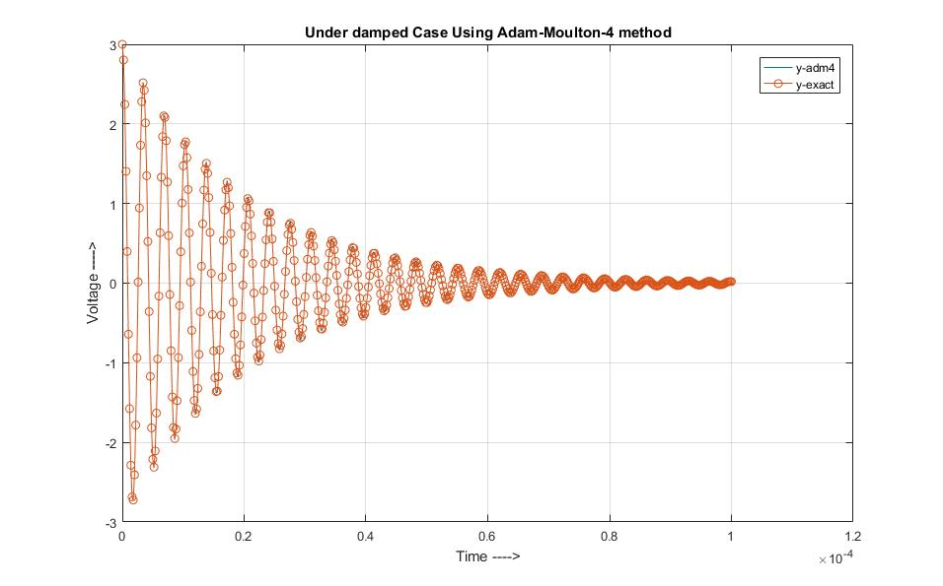

Slide 27
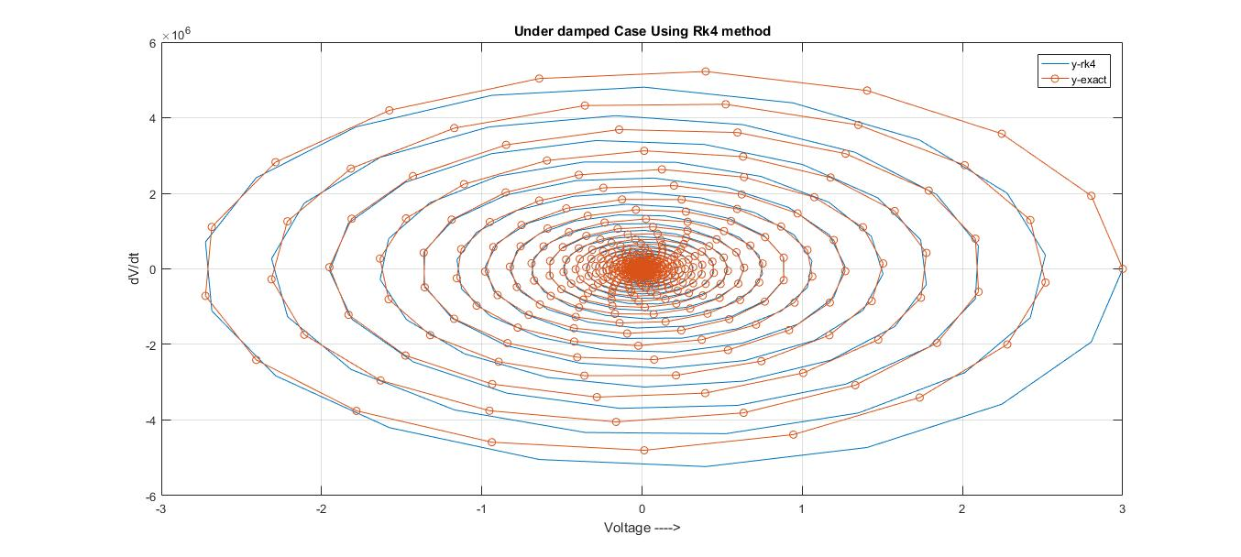

Slide 28
